Slide 1
Chapter 10: Mass-Storage Systems

Slide 2
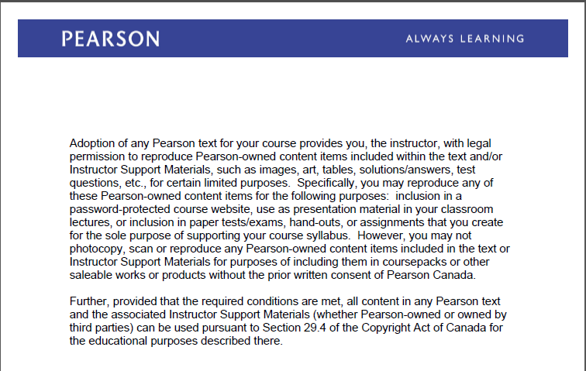
Text Book Slides – Copy Right

Slide 3
Chapter 10: Mass-Storage Systems
Overview of Mass Storage Structure
Disk Structure
Disk Attachment
Disk Scheduling
Disk Management
Swap-Space Management
RAID Structure
Stable-Storage Implementation

Slide 4
Objectives
To describe the physical structure of secondary storage devices and its effects on the uses of the devices
To explain the performance characteristics of mass-storage devices
To evaluate disk scheduling algorithms
To discuss operating-system services provided for mass storage, including RAID

Slide 5
Mass-Storage Management
Usually disks used to store data that does not fit in main memory or data that must be kept for a “long” period of time
Proper management is of central importance
Entire speed of computer operation hinges on disk subsystem and its algorithms
OS activities
Free-space management
Storage allocation
Disk scheduling
Some storage need not be fast
Tertiary storage includes optical storage, magnetic tape
Still must be managed – by OS or applications
Varies between WORM (write-once, read-many-times) and RW (read-write)

Slide 6
Storage Structure

Slide 7
Overview of Mass Storage Structure
Magnetic disks provide bulk of secondary storage of modern computers
Drives rotate at 60 to 250 times per second
Transfer rate is rate at which data flow between drive and computer
Positioning time (random-access time) is time to move disk arm to desired cylinder (seek time) and time for desired sector to rotate under the disk head (rotational latency)
Head crash results from disk head making contact with the disk surface
That’s bad
Disks can be removable
Drive attached to computer via I/O bus
Busses vary, including EIDE, ATA, SATA, USB, Fibre Channel, SCSI, SAS, Firewire
Host controller in computer uses bus to talk to disk controller built into drive or storage array

Slide 8
Storage Structure
Main memory – only large storage media that the CPU can access directly
Random access
Typically volatile
Secondary storage – extension of main memory that provides large nonvolatile storage capacity
Magnetic disks – rigid metal or glass platters covered with magnetic recording material
Disk surface is logically divided into tracks, which are subdivided into sectors
The disk controller determines the logical interaction between the device and the computer
Solid-state disks – faster than magnetic disks, nonvolatile
Various technologies
Becoming more popular

Slide 9
Disk Structure
Disk drives are addressed as large 1-dimensional arrays of logical blocks, where the logical block is the smallest unit of transfer
Low-level formatting creates logical blocks on physical media
The 1-dimensional array of logical blocks is mapped into the sectors of the disk sequentially
Sector 0 is the first sector of the first track on the outermost cylinder
Mapping proceeds in order through that track, then the rest of the tracks in that cylinder, and then through the rest of the cylinders from outermost to innermost
Logical to physical address should be easy
Except for bad sectors
Non-constant # of sectors per track via constant angular velocity

Slide 10
Moving-head Disk Mechanism

Slide 11
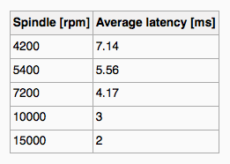
Magnetic Disks
Platters range from .85” to 14” (historically)
Commonly 3.5”, 2.5”, and 1.8”
Range from 30GB to 3TB per drive
Performance
Transfer Rate – theoretical – 6 Gb/sec
Effective Transfer Rate – real – 1Gb/sec
Seek time from 3ms to 12ms – 9ms common for desktop drives
Average seek time measured or calculated based on 1/3 of tracks
Latency based on spindle speed
1/(RPM * 60)
Average latency = ½ latency
(From Wikipedia)

Slide 12
Magnetic Disk Performance
Access Latency = Average access time = average seek time + average latency
For fastest disk 3ms + 2ms = 5ms
For slow disk 9ms + 5.56ms = 14.56ms
Average I/O time = average access time + (amount to transfer / transfer rate) + controller overhead
For example to transfer a 4KB block on a 7200 RPM disk with a 5ms average seek time, 1Gb/sec transfer rate with a .1ms controller overhead =
5ms + 4.17ms + 4KB / 1Gb/sec + 0.1ms =
9.27ms + 4 / 131072 sec =
9.27ms + .12ms = 9.39ms

Slide 13
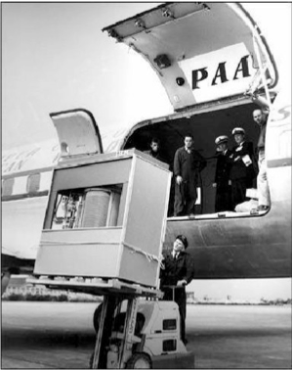
The First Commercial Disk Drive
1956
IBM RAMDAC computer included the IBM Model 350 disk storage system
5M (7 bit) characters
50 x 24” platters
Access time = < 1 second

Slide 14
SSD
Flash memory in some respects is very similar to a computer’s RAM (random access memory), except
that flash memory does not lose its contents when the power is removed, which means that flash
memory is nonvolatile. The most common types of flash memory are NOR and NAND. NOR flash
memory is operationally the closest to RAM in that each byte is individually addressable, while NAND
flash memory is organized into blocks, like a disk. Typically, NOR-type flash memory is used to hold
the BIOS on your computer’s motherboard, and NAND-type flash memory is used in SSDs.

Slide 15
SSD
The file system keeps track of which areas of a disk are currently in use for each file, and when a file
is deleted it does not zero all the areas on the disk that contained the file—if it did, then deleting
a large file would take longer than deleting a small file, and file undelete utilities would not work.
Instead, the file system driver will mark those areas of the disk as available in its data structures (usually
referred to as metadata; see Chapter 12 for more information). This is not a problem for magnetic
disks because they read and write sectors natively, but SSDs do not read and write sectors natively
(recall that the size of the writable unit, the page, is much smaller than the size of the erasable unit,
the block).
SSDs have to manage the contents of pages and blocks when updating a sector. This becomes a
huge problem because the SSD does not know that the contents of a page are free unless it has been
erased. The SSD would continue to preserve “deleted” data when updating a sector or during wearleveling,
reducing the amount of free space available to the SSD controller. The end result would be
that the speed of the SSD would degrade up to the point at which all sectors have been accessed (at
least once), and the only way to speed it up again would be to erase the entire drive. This is exactly
the behavior that existed in early SSDs.

Slide 16
Solid-State Disks
Nonvolatile memory used like a hard drive
Many technology variations
Can be more reliable than HDDs
More expensive per MB
Maybe have shorter life span
Less capacity but much faster than magnetic disk and slower than RAM
Flash memory is significantly faster than magnetic disks
(usually by a factor of 100,000, or so; access time: 50 nanoseconds versus 5 milliseconds), but it is
slower than RAM (usually by a factor of 50).
Busses can be too slow -> connect directly to PCI for example
No moving parts, so no seek time or rotational latency

Slide 17
Storage-Device Hierarchy

Slide 18
Performance of Various Levels of Storage
Movement between levels of storage hierarchy can be explicit or implicit

Slide 19
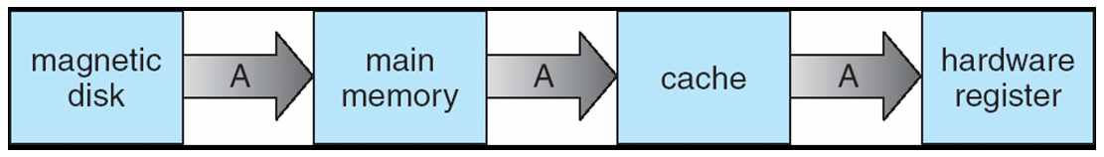
Migration of Integer A from Disk to Register
Multitasking environments must be careful to use most recent value, no matter where it is stored in the storage hierarchy
Multiprocessor environment must provide cache coherency in hardware such that all CPUs have the most recent value in their cache
Distributed environment situation even more complex
Several copies of a datum can exist
Various solutions covered in Chapter 17

Slide 20
Caching
Important principle, performed at many levels in a computer (in hardware, operating system, software)
Information in use copied from slower to faster storage temporarily
Faster storage (cache) checked first to determine if information is there
If it is, information used directly from the cache (fast)
If not, data copied to cache and used there
Cache smaller than storage being cached
Cache management important design problem
Cache size and replacement policy

Slide 21
Magnetic Tape
Was early secondary-storage medium
Evolved from open spools to cartridges
Relatively permanent and holds large quantities of data
Access time slow
Random access ~1000 times slower than disk
Mainly used for backup, storage of infrequently-used data, transfer medium between systems
Kept in spool and wound or rewound past read-write head
Once data under head, transfer rates comparable to disk
140MB/sec and greater
200GB to 1.5TB typical storage
Common technologies are LTO-{3,4,5} and T10000

Slide 22
Disk Management
Low-level formatting, or physical formatting — Dividing a disk into sectors that the disk controller can read and write
Each sector can hold header information, plus data, plus error correction code (ECC)
Usually 512 bytes of data but can be selectable
To use a disk to hold files, the operating system still needs to record its own data structures on the disk
Partition the disk into one or more groups of cylinders, each treated as a logical disk
Logical formatting or “making a file system”
To increase efficiency most file systems group blocks into clusters
Disk I/O done in blocks
File I/O done in clusters
Raw disk access for apps that want to do their own block management, keep OS out of the way (databases for example)
Boot block initializes system
The bootstrap is stored in ROM
Bootstrap loader program stored in boot blocks of boot partition
Methods such as sector sparing used to handle bad blocks

Slide 23
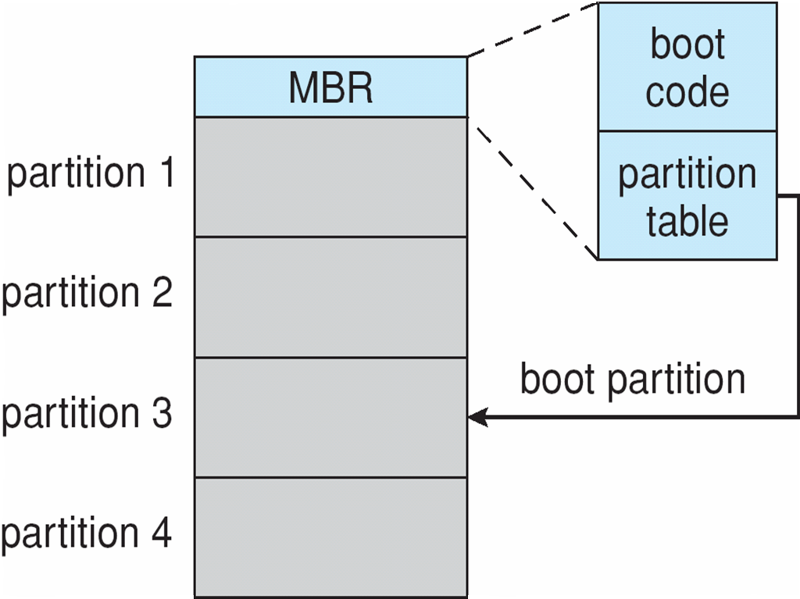
Booting from a Disk in Windows

Slide 24
DISK SCHEDULING

Slide 25
Disk Scheduling
The operating system is responsible for using hardware efficiently — for the disk drives, this means having a fast access time and disk bandwidth
Minimize seek time
Seek time ≈ seek distance
Disk bandwidth is the total number of bytes transferred, divided by the total time between the first request for service and the completion of the last transfer

Slide 26
Disk Scheduling (Cont.)
There are many sources of disk I/O request
OS
System processes
Users processes
I/O request includes input or output mode, disk address, memory address, number of sectors to transfer
OS maintains queue of requests, per disk or device
Idle disk can immediately work on I/O request, busy disk means work must queue
Optimization algorithms only make sense when a queue exists
Note that drive controllers have small buffers and can manage a queue of I/O requests (of varying “depth”)
Several algorithms exist to schedule the servicing of disk I/O requests
The analysis is true for one or many platters
We illustrate scheduling algorithms with a request queue (0-199)
98, 183, 37, 122, 14, 124, 65, 67
Head pointer 53

Slide 27
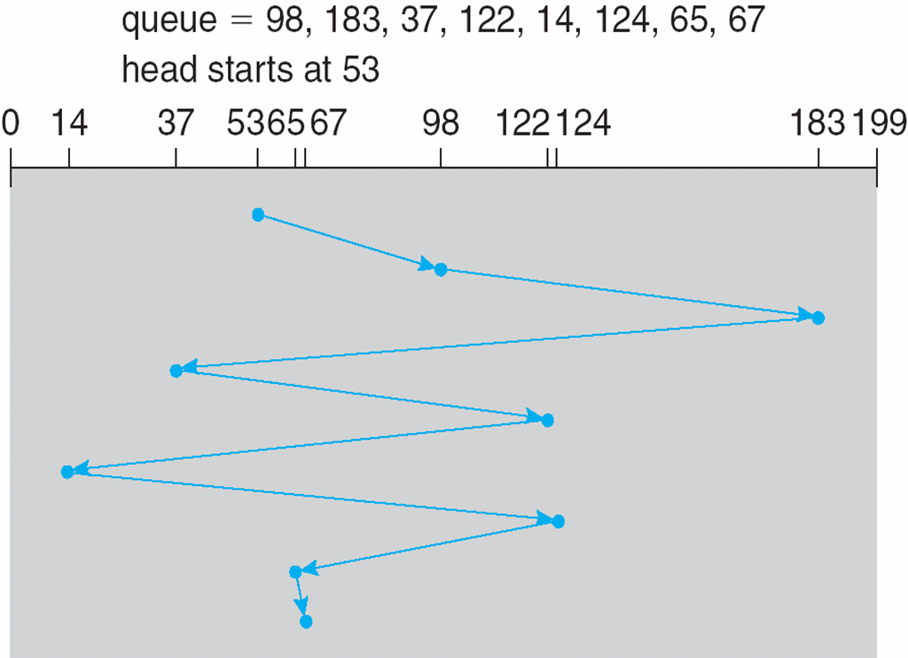
FCFS
Illustration shows total head movement of 640 cylinders

Slide 28
SSTF
Shortest Seek Time First selects the request with the minimum seek time from the current head position
SSTF scheduling is a form of SJF scheduling; may cause starvation of some requests
Illustration shows total head movement of 236 cylinders

Slide 29
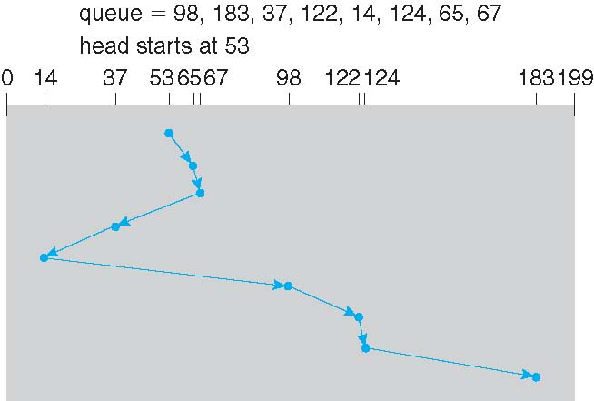
SSTF (Cont.)

Slide 30
SCAN
The disk arm starts at one end of the disk, and moves toward the other end, servicing requests until it gets to the other end of the disk, where the head movement is reversed and servicing continues.
SCAN algorithm Sometimes called the elevator algorithm
Illustration shows total head movement of 208 cylinders
But note that if requests are uniformly dense, largest density at other end of disk and those wait the longest

Slide 31
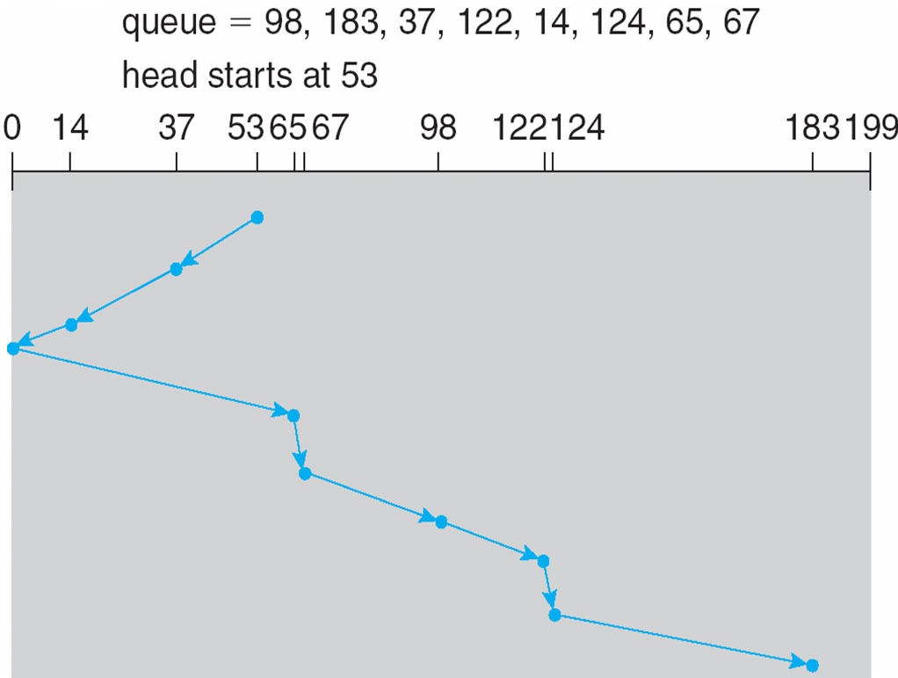
SCAN (Cont.)

Slide 32
C-SCAN
Provides a more uniform wait time than SCAN
The head moves from one end of the disk to the other, servicing requests as it goes
When it reaches the other end, however, it immediately returns to the beginning of the disk, without servicing any requests on the return trip
Treats the cylinders as a circular list that wraps around from the last cylinder to the first one
Total number of cylinders?

Slide 33
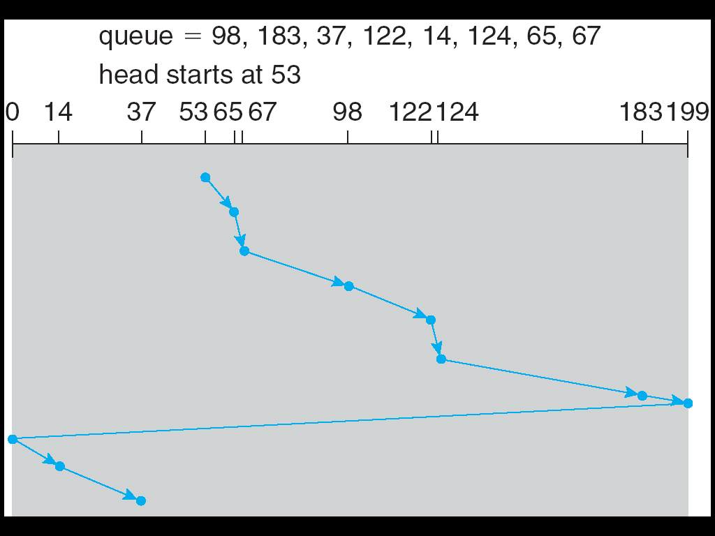
C-SCAN (Cont.)

Slide 34
C-LOOK
LOOK a version of SCAN, C-LOOK a version of C-SCAN
Arm only goes as far as the last request in each direction, then reverses direction immediately, without first going all the way to the end of the disk
Total number of cylinders?

Slide 35
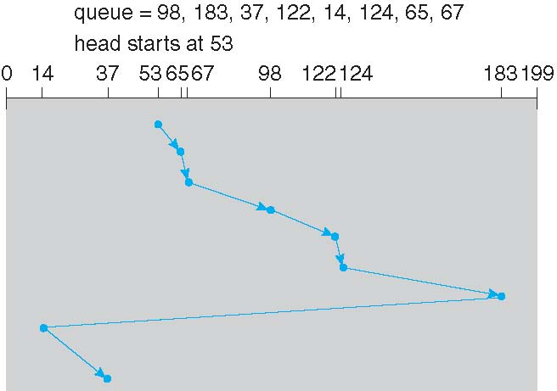
C-LOOK (Cont.)

Slide 36
Selecting a Disk-Scheduling Algorithm
SSTF is common and has a natural appeal
SCAN and C-SCAN perform better for systems that place a heavy load on the disk
Less starvation
Performance depends on the number and types of requests
Requests for disk service can be influenced by the file-allocation method
And metadata layout
The disk-scheduling algorithm should be written as a separate module of the operating system, allowing it to be replaced with a different algorithm if necessary
Either SSTF or LOOK is a reasonable choice for the default algorithm
What about rotational latency?
Difficult for OS to calculate
How does disk-based queuing effect OS queue ordering efforts?

Slide 37
Internal and external Storage Devices

Slide 38
Internal and External Storage devices
In internal-storage configurations, drives are connected inside the server chassis to a local disk controller and are said to be directly attached. You’ll sometimes see an internal storage device referred to as direct-attached storage (DAS)
In external-storage configurations, servers connect to external, separately managed collections of storage devices that are either network-attached ( NAS ) or part of a storage area network (SAN).

Slide 39
Disk Attachment
Host-attached storage accessed through I/O ports talking to I/O busses
SCSI itself is a bus, up to 16 devices on one cable, SCSI initiator requests operation and SCSI targets perform tasks
Each target can have up to 8 logical units (disks attached to device controller)
FC (fiber channel) is high-speed serial architecture
Can be switched fabric with 24-bit address space – the basis of storage area networks (SANs) in which many hosts attach to many storage units
FC networks can use a variety of topologies, including the following:
Point-to-point (FC-PTP), where two devices are connected directly.
Switched fabric (FC-SW), where all devices or device rings are connected to switches,
similar to Ethernet
I/O directed to bus ID, device ID, logical unit (LUN)

Slide 40
Storage Array
Can just attach disks, or arrays of disks
Storage Array has controller(s), provides features to attached host(s)
Ports to connect hosts to array
Memory, controlling software (sometimes NVRAM, etc)
A few to thousands of disks
RAID, hot spares, hot swap (discussed later)
Shared storage -> more efficiency
Features found in some file systems
Snaphots, clones, thin provisioning, replication, deduplication, etc

Slide 41
Network-Attached Storage (NAS)
NAS devices are connected through a regular Transmission Control Protocol/Internet Protocol (TCP/IP) network. All server-storage communications go across the organization’s local area network (LAN)
NAS typically use file-based protocols for communications, which can include
Server Message Block (SMB),
Distributed File System (DFS), and
Network File System (NFS).
This means the available bandwidth on the network can be shared by clients, servers, and NAS devices. For best performance, the network should be running at 1 gigabit per second (Gbps) or higher. Networks operating at slower speeds can experience a serious decrease in performance as clients, services, and storage devices try to communicate using the limited bandwidth.

Slide 42
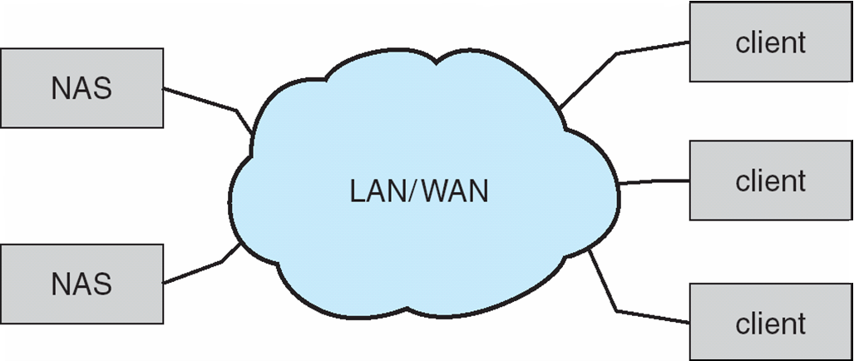
Network-Attached Storage (NAS)
Network-attached storage (NAS) is storage made available over a network rather than over a local connection (such as a bus)
Remotely attaching to file systems
NFS and CIFS are common protocols
Implemented via remote procedure calls (RPCs) between host and storage over typically TCP or UDP on IP network
iSCSI protocol uses IP network to carry the SCSI protocol
Remotely attaching to devices (blocks)

Slide 43
Storage Area Network(SAN)
A SAN typically is physically separate from the LAN and is independently managed. As
this isolates the server-to-storage communications so that traffic doesn’t affect communications between clients
and servers.
SAN technologies uses:
Fibre Channel Protocol (FCP), a more traditional SAN technology that delivers high reliability and performance, and
Internet SCSI (iSCSI), which delivers good reliability and performance at a lower cost than Fibre Channel. As the name implies, iSCSI uses TCP/IP networking technologies on the SAN so that servers can communicate with storage devices using IP. The SAN is still isolated from the organization’s LAN

Slide 44
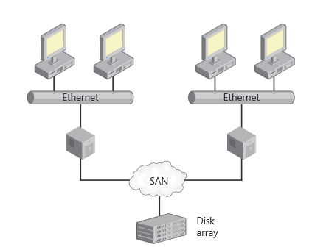
SAN

Slide 45
Storage Area Network(SAN)
Common in large storage environments
Multiple hosts attached to multiple storage arrays - flexible

Slide 46
Storage Area Network (Cont.)
SAN is one or more storage arrays
Connected to one or more Fibre Channel switches
Hosts also attach to the switches
Storage made available via LUN Masking from specific arrays to specific servers
Easy to add or remove storage, add new host and allocate it storage
Over low-latency Fibre Channel fabric
Why have separate storage networks and communications networks?
Consider iSCSI, FCoE (Fiber Channel over Ethernet)
Fibre Channel over Ethernet (FCoE), a technology that allows IP network and SAN data traffic to be consolidated on a single network. FCoE encapsulates Fibre Channel frames over Ethernet and supports 10-Gbps
and higher networks. This is different from iSCSI, which runs on top of TCP and IP. Additionally, while iSCSI is
routable across IP networks, FCoE isn’t routable in the IP layer and won’t work across routed IP networks.

Slide 47
Swap-Space Management
Swap-space — Virtual memory uses disk space as an extension of main memory
Less common now due to memory capacity increases
Swap-space can be carved out of the normal file system, or, more commonly, it can be in a separate disk partition (raw)
Swap-space management
4.3BSD allocates swap space when process starts; holds text segment (the program) and data segment
Kernel uses swap maps to track swap-space use
Solaris 2 allocates swap space only when a dirty page is forced out of physical memory, not when the virtual memory page is first created
File data written to swap space until write to file system requested
Other dirty pages go to swap space due to no other home
Text segment pages thrown out and reread from the file system as needed
What if a system runs out of swap space?
Some systems allow multiple swap spaces

Slide 48
Data Structures for Swapping on Linux Systems

Slide 49
Basic and Dynamic Disks
Basic disks and dynamic disks are managed in different ways. For basic disks, you use primary and extended partitions. Extended partitions can contain logical drives.
Dynamic disks allow you to combine disks to create spanned volumes, to mirror disks to create mirrored volumes, and to stripe disks using RAID 0 to create striped volumes. You can also create RAID-5 volumes for high reliability on dynamic disks

Slide 50
Dynamic Disks
Dynamic disks have dynamic volumes that can be created as the following types:
Simple volumes. A simple volume is a volume that’s on a single drive and has the same purpose as a primary partition.
Spanned volumes. A spanned volume is a volume that spans multiple drives.
Striped volumes. A striped volume is a volume that uses RAID 0 to combine multiple disks into a striped set.
Mirrored volumes. A mirrored volume is a volume that uses RAID 1 to mirror a primary disk onto a secondary disk that is available for disaster recovery.
RAID-5 volumes. A RAID-5 volume is a volume that uses RAID 5 to create a fault-tolerant striped set on three or more disks.

Slide 51
RAID Structure
RAID – redundant array of inexpensive disks
multiple disk drives provides reliability via redundancy
Increases the mean time to failure
Mean time to repair – exposure time when another failure could cause data loss
Mean time to data loss based on above factors
If mirrored disks fail independently, consider disk with 1300,000 mean time to failure and 10 hour mean time to repair
Mean time to data loss is 100, 000² / (2 ∗ 10) = 500 ∗ 10⁶ hours, or 57,000 years!
Frequently combined with NVRAM to improve write performance
RAID is arranged into six different levels

Slide 52
RAID (Cont.)
Several improvements in disk-use techniques involve the use of multiple disks working cooperatively
Disk striping uses a group of disks as one storage unit
RAID schemes improve performance and improve the reliability of the storage system by storing redundant data
Mirroring or shadowing (RAID 1) keeps duplicate of each disk
Striped mirrors (RAID 1+0) or mirrored stripes (RAID 0+1) provides high performance and high reliability
Block interleaved parity (RAID 4, 5, 6) uses much less redundancy
RAID within a storage array can still fail if the array fails, so automatic replication of the data between arrays is common
Frequently, a small number of hot-spare disks are left unallocated, automatically replacing a failed disk and having data rebuilt onto them

Slide 53
RAID Levels

Slide 54
RAID (0 + 1) and (1 + 0)

Slide 55
Windows Volume Management
FtDisk, the fault tolerant disk driver for Windows 7, provides several ways to combine multiple SCSI disk drives into one logical volume
Logically concatenate multiple disks to form a large logical volume, a volume set
Interleave multiple physical partitions in round-robin fashion to form a stripe set (also called RAID level 0, or “disk striping”)
Variation: stripe set with parity, or RAID level 5
Disk mirroring, or RAID level 1, is a robust scheme that uses a mirror set — two equally sized partitions on tow disks with identical data contents
To deal with disk sectors that go bad, FtDisk, uses a hardware technique called sector sparing and NTFS uses a software technique called cluster remapping

Slide 56
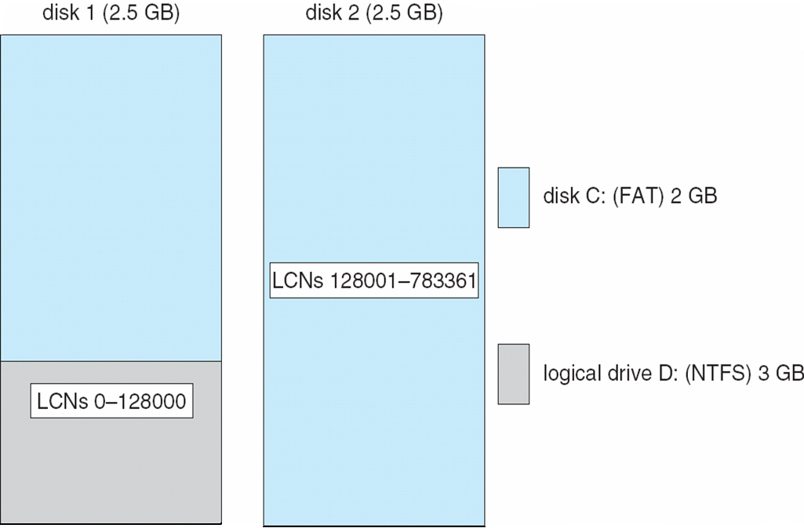
Volume Set On Two Drives

Slide 57
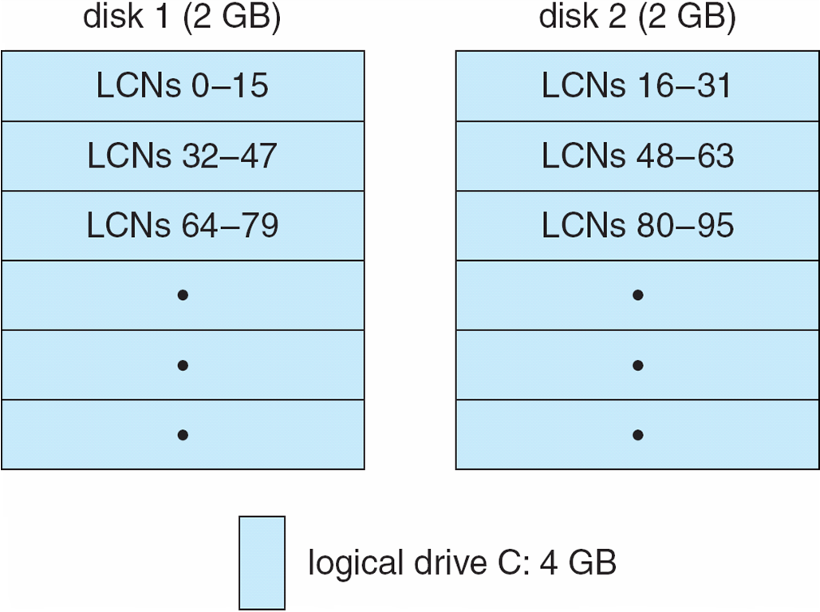
Stripe Set on Two Drives

Slide 58
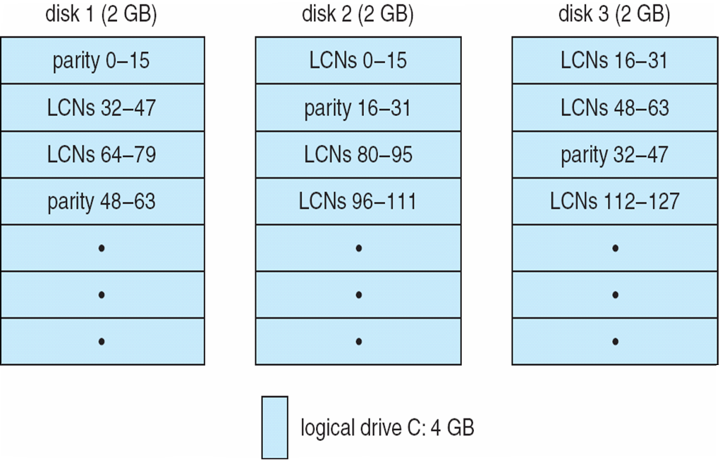
Stripe Set With Parity on Three Drives

Slide 59
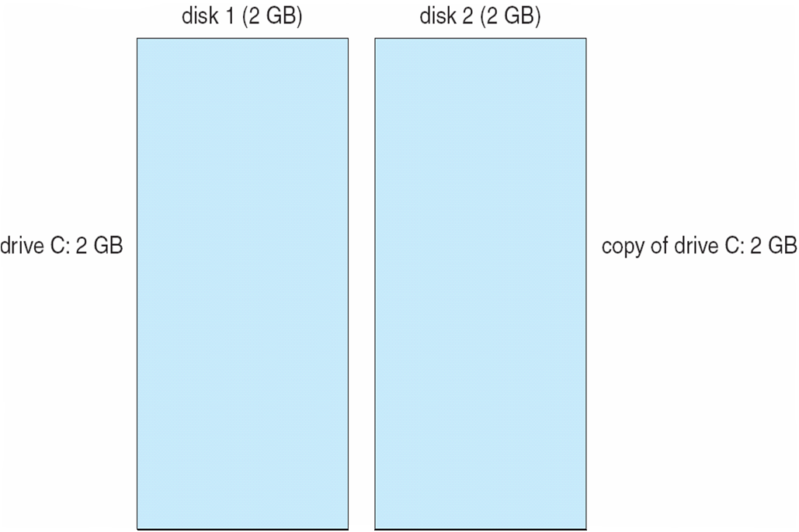
Mirror Set on Two Drives

Slide 60
Other Features
Regardless of where RAID implemented, other useful features can be added
Snapshot is a view of file system before a set of changes take place (i.e. at a point in time)
More in Ch 12
Replication is automatic duplication of writes between separate sites
For redundancy and disaster recovery
Can be synchronous or asynchronous
Hot spare disk is unused, automatically used by RAID production if a disk fails to replace the failed disk and rebuild the RAID set if possible
Decreases mean time to repair

Slide 61
Extensions
RAID alone does not prevent or detect data corruption or other errors, just disk failures
Solaris ZFS adds checksums of all data and metadata
Checksums kept with pointer to object, to detect if object is the right one and whether it changed
Can detect and correct data and metadata corruption
ZFS also removes volumes, partititions
Disks allocated in pools
Filesystems with a pool share that pool, use and release space like “malloc” and “free” memory allocate / release calls

Slide 62
ZFS Checksums All Metadata and Data

Slide 63
Traditional and Pooled Storage

Slide 64
Stable-Storage Implementation
Write-ahead log scheme requires stable storage
Stable storage means data is never lost (due to failure, etc)
To implement stable storage:
Replicate information on more than one nonvolatile storage media with independent failure modes
Update information in a controlled manner to ensure that we can recover the stable data after any failure during data transfer or recovery
Disk write has 1 of 3 outcomes
Successful completion - The data were written correctly on disk
Partial failure - A failure occurred in the midst of transfer, so only some of the sectors were written with the new data, and the sector being written during the failure may have been corrupted
Total failure - The failure occurred before the disk write started, so the previous data values on the disk remain intact
If failure occurs during block write, recovery procedure restores block to consistent state
System maintains 2 physical blocks per logical block and does the following:
Write to 1st physical
When successful, write to 2nd physical
Declare complete only after second write completes successfully
Systems frequently use NVRAM as one physical to accelerate

Slide 65
Block and Object Storage
https://www.redhat.com/en/technologies/storage
https://en.wikipedia.org/wiki/Gluster

Slide 66
Text Book Slides – Copy Right

Slide 67
End of Chapter 10

